Slide 1

Professor Pranati Panda
Professor and Head
Head, School Standards and Evaluation Unit
National University of Educational Planning and Administration (NUEPA)
17-B ,Sri Aurobindo Marg, New Delhi-110016, INDIA
Phone: 011-26544815
SHAALA SIDDHI
Evaluation For Improvement
School Standards and Evaluation

Slide 2



Slide 3
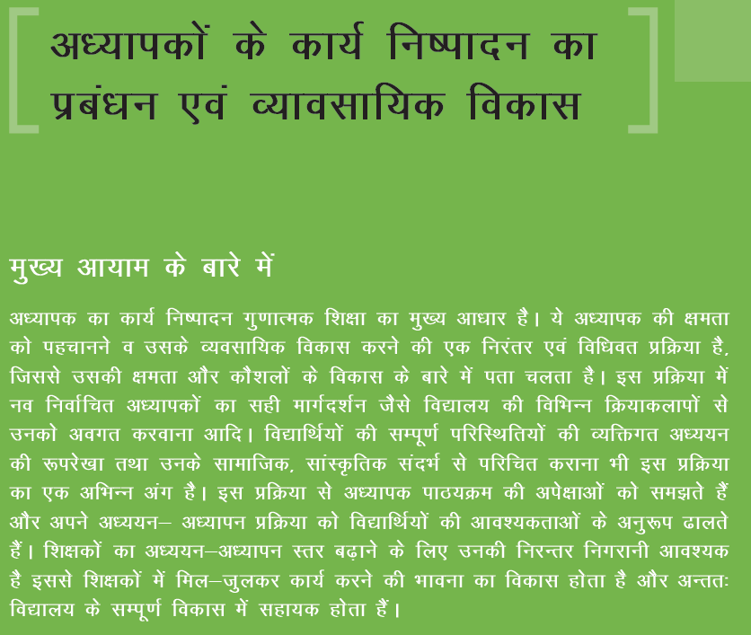

Slide 4
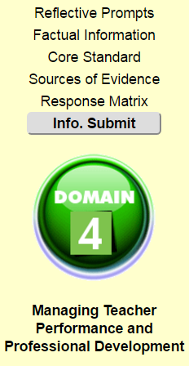


Slide 5
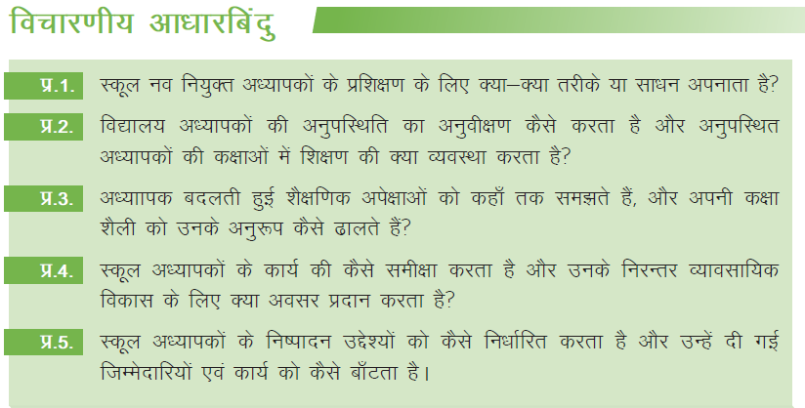

Slide 6
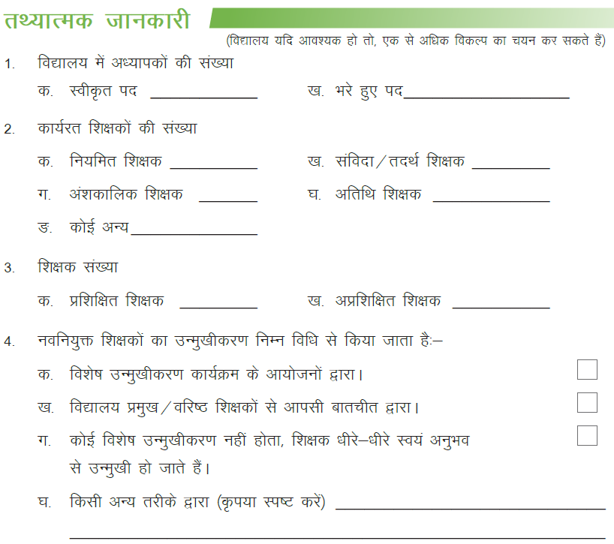

Slide 7
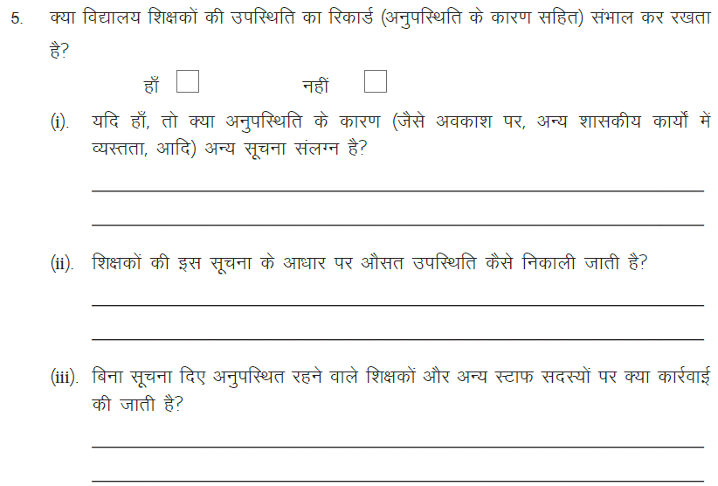

Slide 8
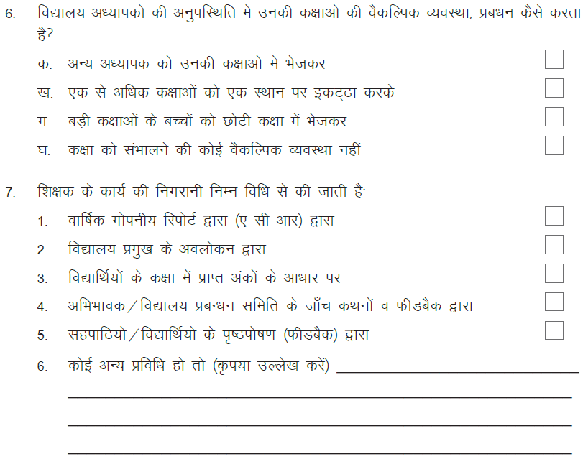

Slide 9
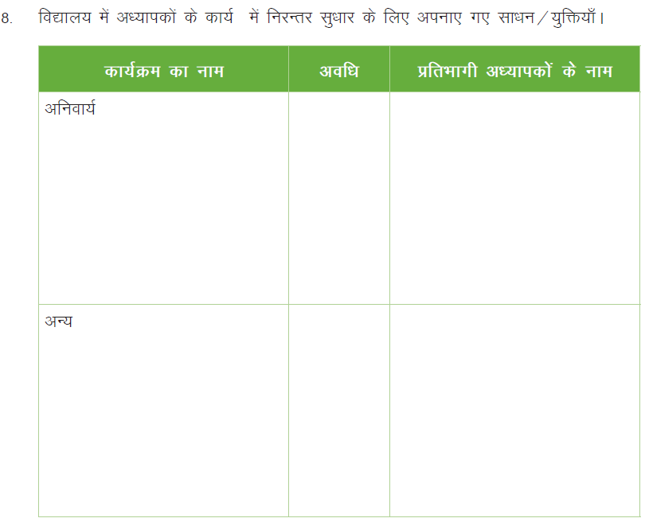

Slide 10
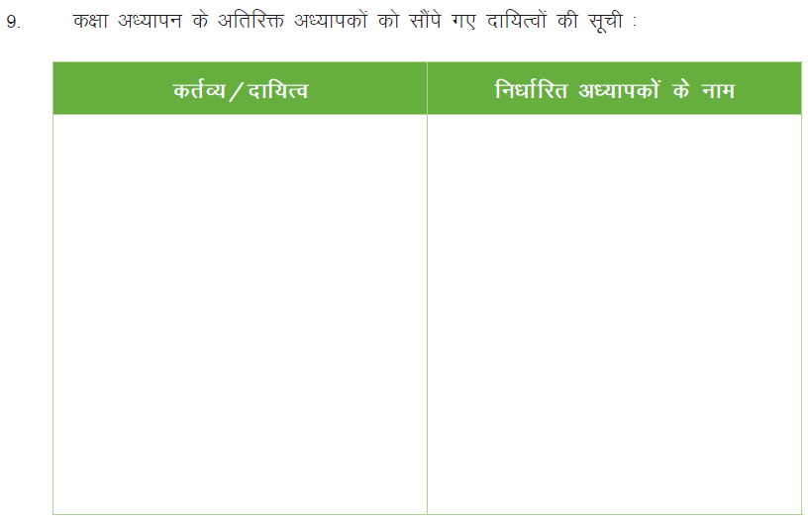

Slide 11
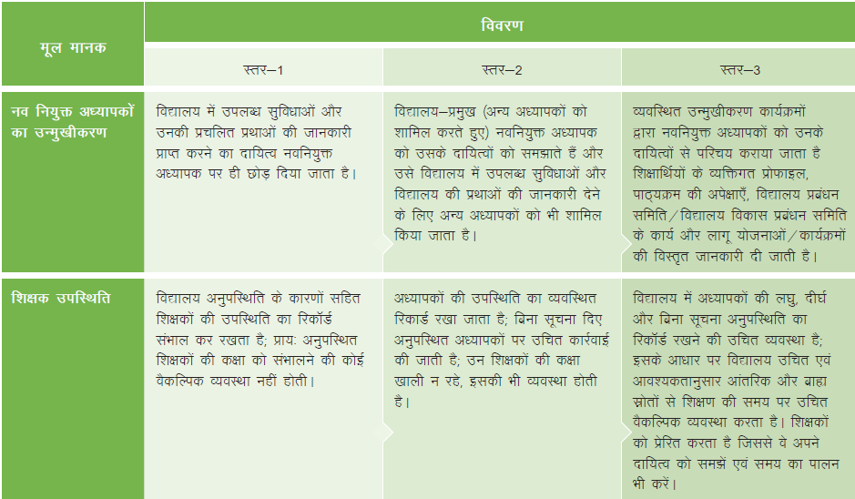

Slide 12
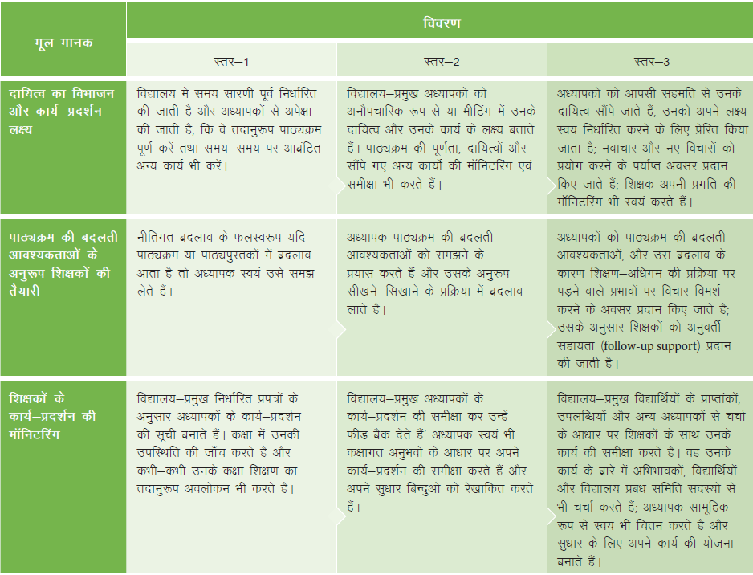

Slide 13
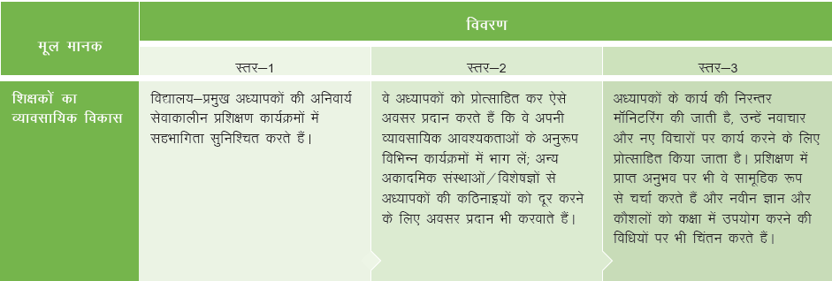


Slide 14

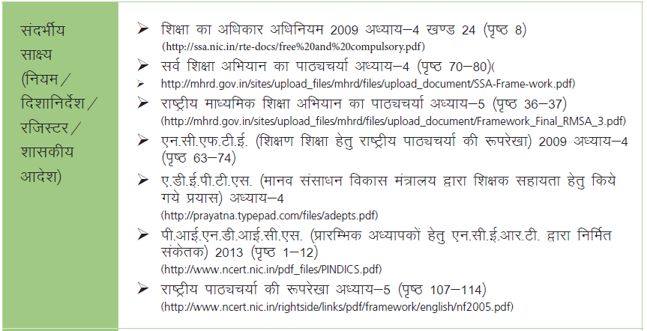

Slide 15
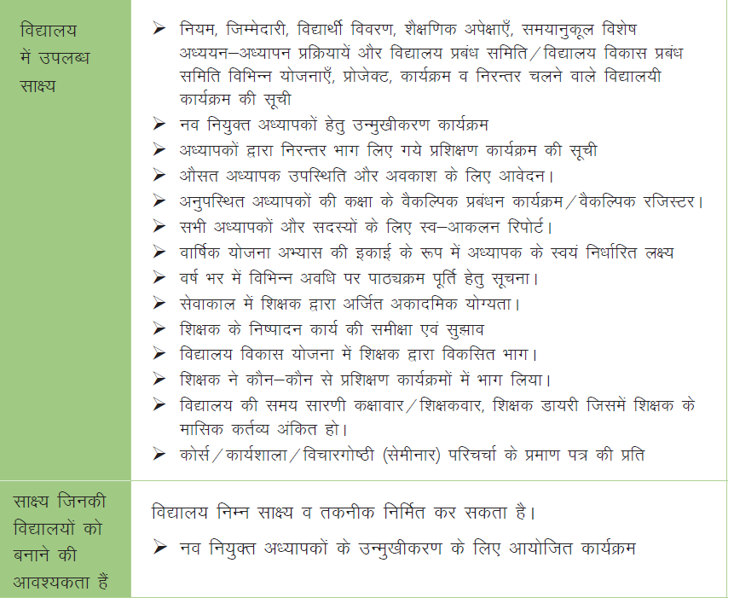

Slide 16



Slide 17

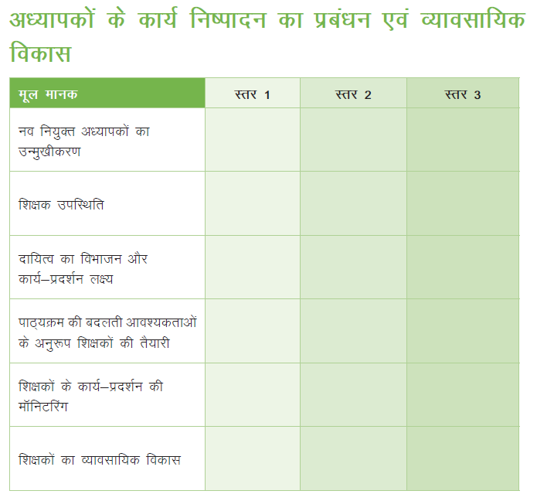

Slide 18
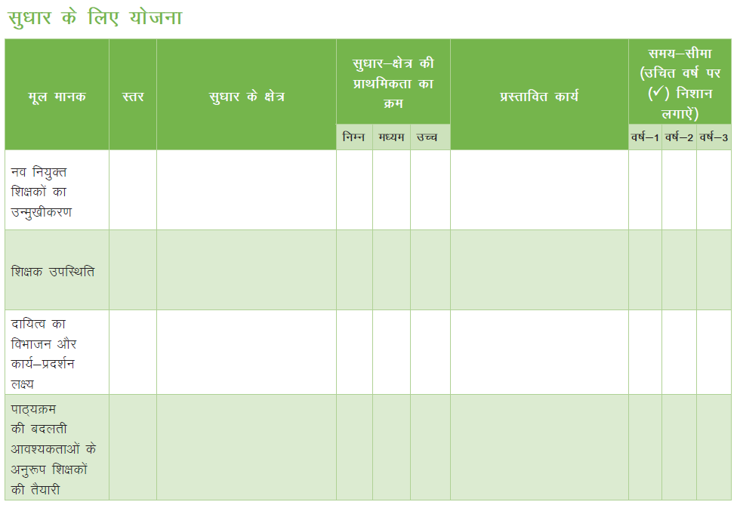

Slide 19
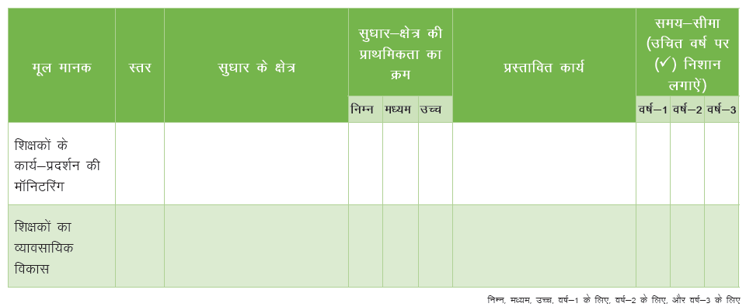

Slide 20
Thank you

